Slide 1

PROG POE PART 1
How to make a chat Bot
By: Philasande Mkhize st10486606

Slide 2
Classes and Methods:
PROGRAM METHODS:
MAIN()
ASK()
ACSIIART
METHODS:
1. IMAGEMAKER()
2. BORDERMAKER()
TEXTTOSPEECH
METHODS:
1. Speak()

Slide 3
Program

Slide 4
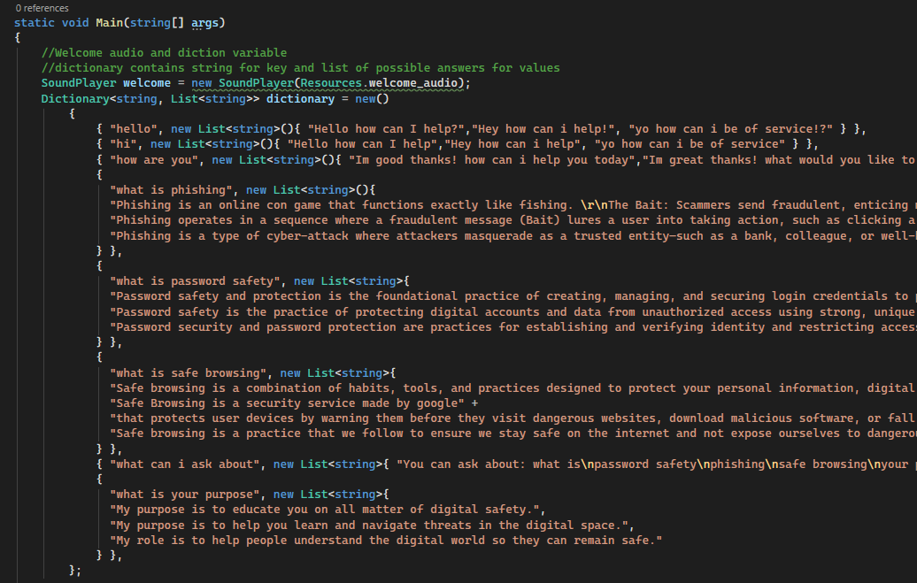
Main()
Main is where the program starts.
It holds important variables like dictionary and welcome
The Dictionary holds key value pairs and this is where our bot responses come from. They are determined by the Key/question the user asks.
The welcome variable is a sound player var and it holds the welcome audio of the app

Slide 5
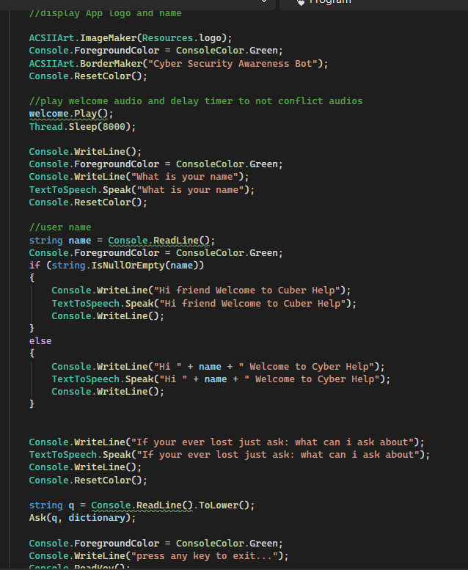
Here the welcome audio will play and the user will be prompted to enter their name.
Then they are free to learn about internet safety
ACSIIART.ImageMaker() – displays ascii art of any image and displays it, in this case our logo
ACSIIART. BorderMaker() – displays a border around text giving it importance

Slide 6
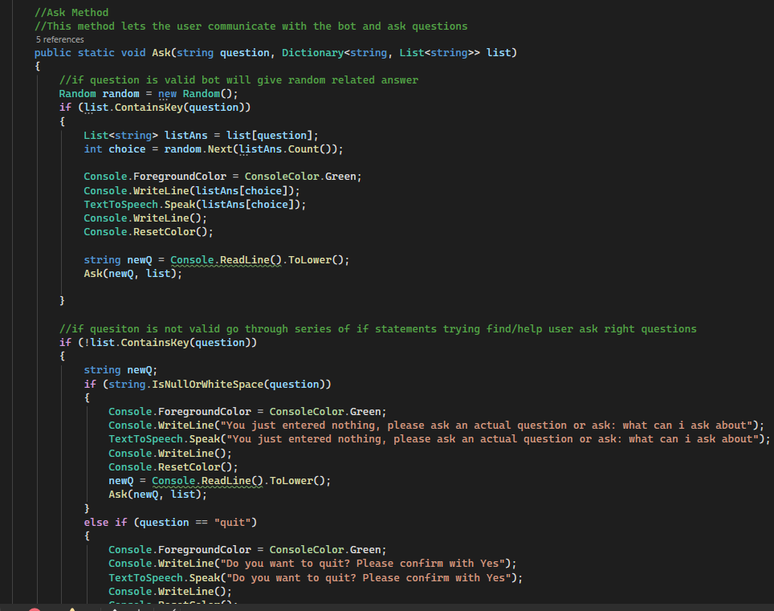
Ask()
This is the Ask method.
This method handles the main input and output. It takes 2 arguments, user input and dictionary list.
If the user enters a valid question, which would be a key in the dictionary then a random related answer will be returned by the bot, otherwise the they will be advised to ask more inline questions to what the bot can answer.

Slide 7
ACSIIART

Slide 8
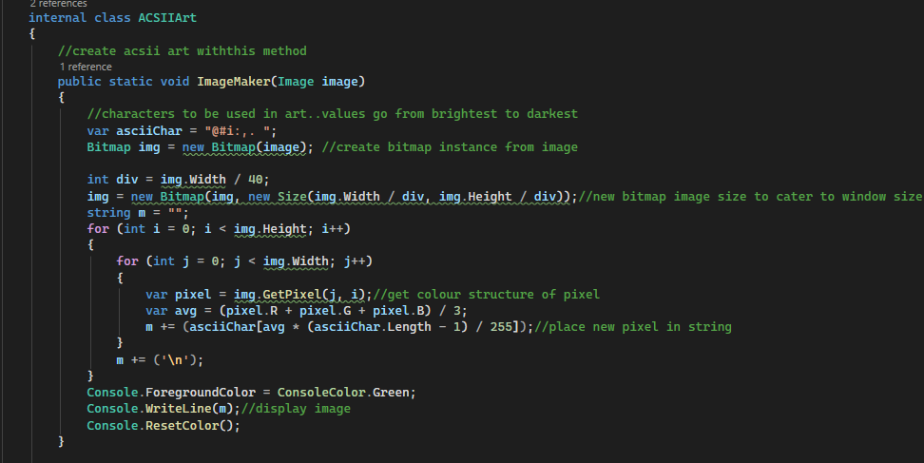
ImageMaker()
The ImageMaker() method creates the ascii images by collecting pixel data of an image using the Bitmap() class, creating a new image size to fit our window preference then iterating over the image size and creating the image with ascii characters bases on light values.

Slide 9
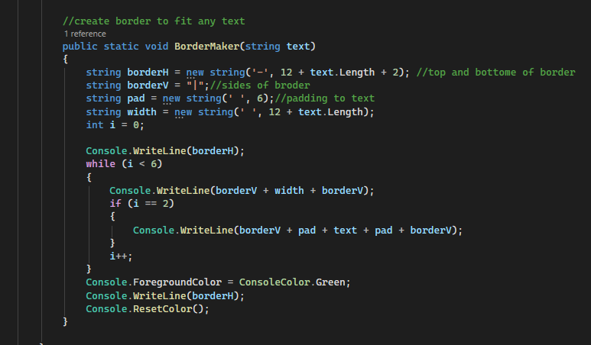
BorderMaker()
The BorderMaker() method creates a border around text by creating a top/bottom border line based of the text size and side border size of our choosing. We achieve the border effect by printing the top border, iterating over the border height and printing the border sides then when half way we print the text and finally at the end print the bottom of the border

Slide 10
TextToSpeech

Slide 11
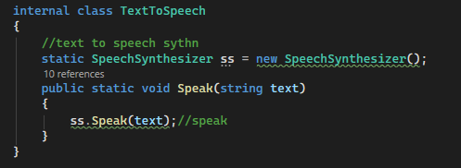
Speak()
To get a robotic voice reader we use the SpeechSynthesizer() class.
We just instantiate an object of it and use the speak method while passing in the text we want spoken.

